Slide 2
Think about getting a failing grade.
What do you hear other people say when they get a failing grade?
What does a failing grade mean, anyway? What does it indicate about you?
What does LASA say about failing grades?
What would you say to yourself about that grade, the assignment, the teacher, about yourself?
What do you think your peers would say?
What about your parents?

Slide 3
Carol Dweck’s TED Talk
https://www.ted.com/talks/carol_dweck_the_power_of_believing_that_you_can_improve?language=en

Slide 4
Carol Dweck’s research:
Fixed Mindset
Growth Mindset
In a fixed mindset, people believe their basic qualities, like their intelligence or talent, are simply fixed traits. They spend their time documenting their intelligence or talent instead of developing them. They also believe that talent alone creates success—without effort.
In a growth mindset, people believe that their most basic abilities can be developed through dedication and hard work—brains and talent are just the starting point. This view creates a love of learning and a resilience that is essential for great accomplishment.

Slide 5
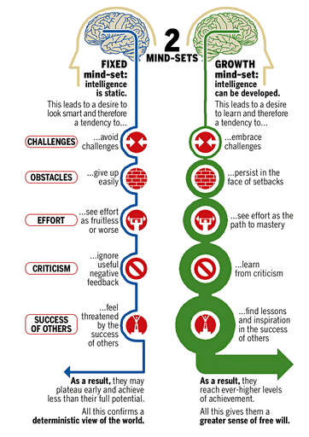

Slide 6
We find that many students value learning above grades. They tell us directly that it is more important to them to learn and be challenged than it is to earn the best grades. Many other students, however, tell us the reverse. They care far more about their grades than they do about learning anything or being challenged.
To my mind, it's the balance that counts -- keeping a balance between valuing learning and performance. Let's face it, grades often matter a lot, and many students who want to go on to top graduate and professional schools need good grades. Problems arise when students come to care so much about their performance that they sacrifice important learning opportunities and limit their intellectual growth.
Problems also arise when students equate their grades with their intelligence or their worth. This can be very damaging, for when they hit difficulty, they may quickly feel inadequate, become discouraged and lose their ability or their desire to perform well in that area.
For me the best mix is a combination of (a) valuing learning and challenge and (b) valuing grades but seeing them as merely an index of your current performance, not a sign of your intelligence or worth.

Slide 7
…And finally, when given a chance to write to a student in another school about the task, 40 percent of the students who received intelligence praise lied about their score. They revised it upward. Very few effort-praised students did so. This suggests that when students are praised for their intelligence, they become so over-identified with their performance, so personally humiliated by setbacks, that they can't tell the truth even to an anonymous peer they will never meet.

Slide 8
Can anything be done?
What could you do to change from a fixed mindset to a growth mindset within yourself?
How does the culture of LASA need to change to support you?
How do the conversations at your house need to change? What about the conversations among your friends?

