Slide 1
Some History of Education

Slide 2
Keep in Mind
The educational “system” that you experience is like nothing Locke/Rousseau could have imagined
They are discussing education of gentlemen (private tutors, family education)
They are not arguing for a uniform, democratic education available to the masses

Slide 3
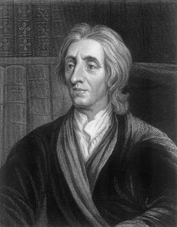
John Locke
1623-1704
England
Humans have certain inalienable rights; society/gov’ts are created to protect those rights
Major Works:
Second Treatise on Gov’t

Slide 4
From Some Thoughts on Education
Childhood as a meaningful period of life
Acknowledges individuality and autonomy of children (they have a right to property too!)
Don’t forget the Chain of Being though!!!!!
Discourages use of physical force against children
Education: prepares one for freedom & teaches you not to impinge on the freedoms of others
Make learning enjoyable for children!

Slide 5
Enlightenment and Education
(In Theory)
Knowledge = means of overcoming social and political evils
Reason → Truth (via an analytical process)
Education→ makes citizens free by liberating minds from prejudice

Slide 6
Enlightenment and Education
Influenced by the Scientific Revolution
Rapid growth in literacy rates in Europe from 17th to 18th century
Education becoming accessible to people of more social classes

Slide 7
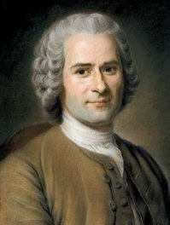
Jean-Jacques Rousseau
1712-1778
Switzerland and France
Humans are amoral by nature, corrupted by human institutions
Major works:
Social Contract
Emile

Slide 8
From Emile
Stages of development
0-12, 12-15 (reason takes hold, use of apprenticeships), 15-adulthood
Young children are like animals
must be allowed to grow up unhindered by formal education
Goal: Developing a health sense of self-worth and morality
2 important features in all people:
Appropriate self-love
Vanity

Slide 9
Should children read fables?
Locke: YES!
Pleasure of figuring out the real meaning behind the story → inspires a child to take on the lessons the story intends to each
Rousseau: NO!
Child will feel he’s in on the joke of the fable → flattery, vanity are the child’s take-away, not the lesson the story intends to teach.
Children identify with the strong/winning/smartest characters always and miss the lesson

Slide 10
Where this leads in America
Thomas Jefferson → stresses importance of a civic education for a democratic nation
Benjamin Franklin → argues for scientific education in American schools
See education as a tool for social improvement!

Slide 11
Where this leads in America
Revolution – pre Civil War:
Lots of schools (education is highly valued for the privileged classes)
Public and private institutions
Private institutions were often religious
Compulsory Public Education:
Passed between 1852-1918 in states

Slide 12
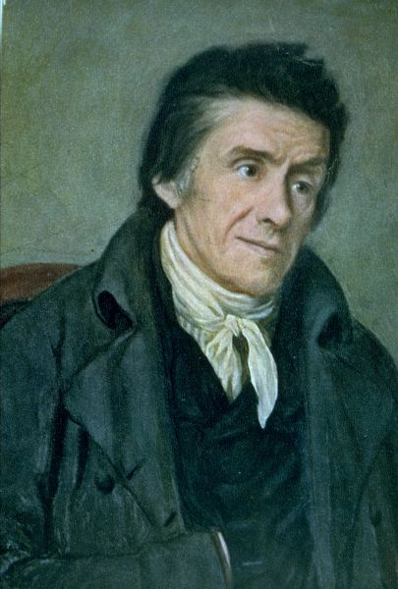
Johann Heinrich Pestalozzi
1746-1827
Switzerland
Inspired by philosophers like Locke and Rousseau
Produces a true educational method
Creates schools
"Learning by head, hand and heart"

Slide 13
Pestalozzi
Belief about children:
Thought begins with sensation; are naturally good; education should nurture their innate goodness
Educational method:
Children should learn through their senses, by seeing objects in their natural environment
Principles:
Begin with a concrete object before the abstract
Begin with what is immediate before the remote
Begin with easier tasks and the move to more complex
Proceed gradually, cumulatively and slowly

Slide 14
4 Eras in US Education
Permissive: (1640s-1820s) gov’t allows formation of public schools (with local support)
Encouraging: (1820s-1850s) gov’t encourages the formation of school districts, but doesn’t require attendance
Compulsory: (1850s-1980s) children must attend school
Freedom of Choice: (1980s-now) lots of options for schools = homeschooling, charter, vouchers

Slide 15
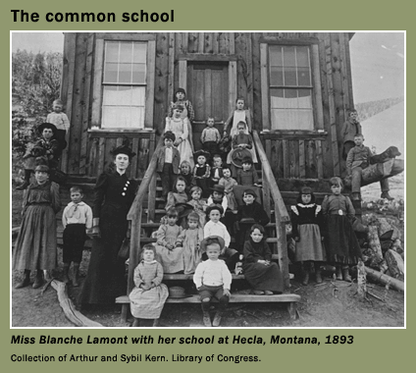
Common Schools
1840s: free schooling for the (white) masses
Trying to create a more homogeneous population
Belief that education prevents crime and creates social stability
Reading, writing, arithmetic

Slide 16
High Schools
1880s-1910: High schools move from being exclusively college prep to broader aims (seen as part of the larger common school movement)
Add gymnasiums, sports, vocational training

